Slide 1
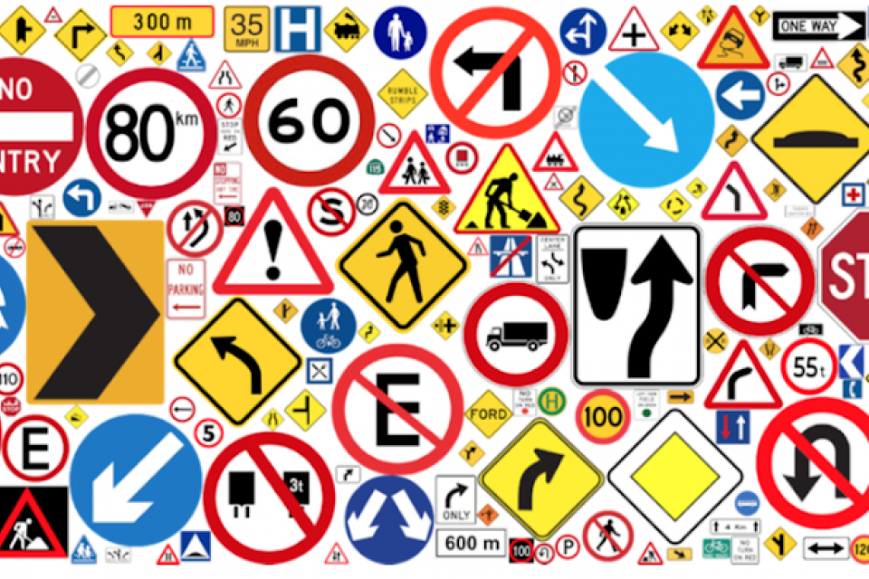


Traffic Sign Recognition using CNN with deployment
By Harsh Mishra

Slide 2
Introduction
Project Title: Traffic Sign Recognition using Convolutional Neural Networks
Objective: Enhance road safety through automated recognition of traffic signs using deep learning.
Importance: Accurate traffic sign recognition aids in real-time decision-making for both human drivers and autonomous vehicles.
Technologies Used: Python, TensorFlow, Keras, OpenCV, NumPy, and pandas.

Slide 3


Our AIM
Our main aim is to Develop and deployed a real time Traffic Sign Recognition System using deep learning. Trained CNN model on annotated traffic sign images and deployed on target hardware. achieved accurate detection and classification of various signs.

Slide 4
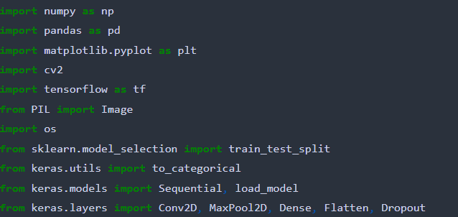
Libraries and Tools
These libraries and tools collectively enable data preprocessing, model building, training, and evaluation.
Libraries Used:
Numpy: Efficient numerical computations.
Pandas: Data manipulation and analysis.
Matplotlib: Data visualization and plotting.
cv2 (OpenCV): Image processing and computer vision tasks.
Tensorflow: Deep learning framework for building models.
Keras: High-level neural networks API for model construction.
Key Tools :
Jupyter Notebook: Development and testing of code.
python: Core programming language for the project..
scikit-learn: Machine learning library for model evaluation and metrics.

Slide 5
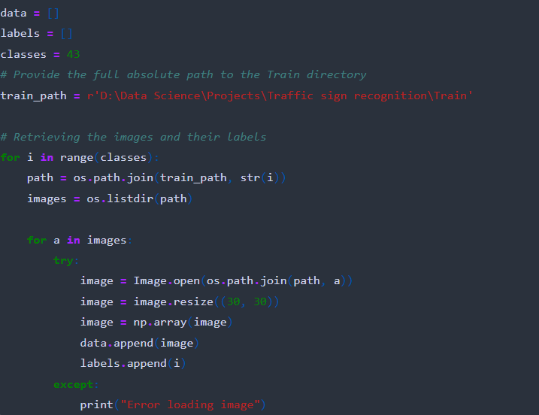
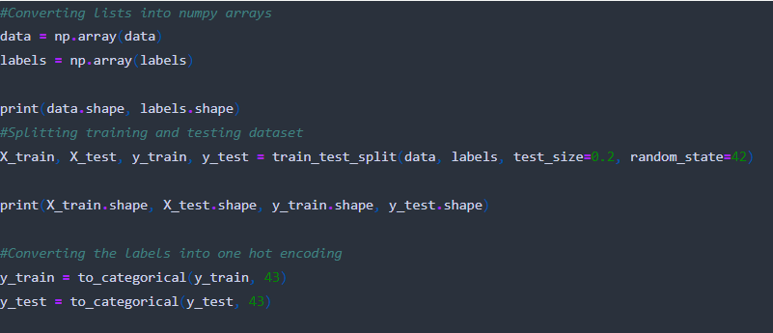
Data Loading and Preprocessing
Data loading and preprocessing are crucial steps to ensure data quality and model compatibility.
Data Loading:
Utilized pandas to load and manipulate dataset.
Loaded images and labels from different traffic sign classes.
Data Preprocessing:
Resized images to a common dimension (30x30) for consistency.
Converted images to NumPy arrays for compatibility with neural networks.
Handled exceptions for error-free data loading.

Slide 6
Data Splitting
Data splitting ensures a separate dataset for model training and evaluation, preventing overfitting
Train-Test Split:
Split the dataset into training and testing subsets.
Used sklearn's train_test_split function.
Common practice: 80% training, 20% testing.
Dataset Shapes:
Training data shape: (number of samples, width, height, channels)
Testing data shape: (number of samples, width, height, channels)

Slide 7
Model Architecture, Compilation, and Training
Model Architecture:
Sequential layers used for the CNN model.
Key layers: Conv2D, MaxPool2D, Dropout, Flatten, Dense.
Convolutional layers for feature extraction, pooling for down sampling, and dense layers for classification.
Model Compilation:
Compilation process involves specifying model components.
Loss function: categorical cross-entropy.
Optimizer: Adam optimizer for weight updates.
Metrics: Accuracy for evaluation.
Model Training:
Training using the ‘fit’ function.
Number of epoch : 15.
Batch Size:32.
Validation data used to monitor performance.

Slide 8
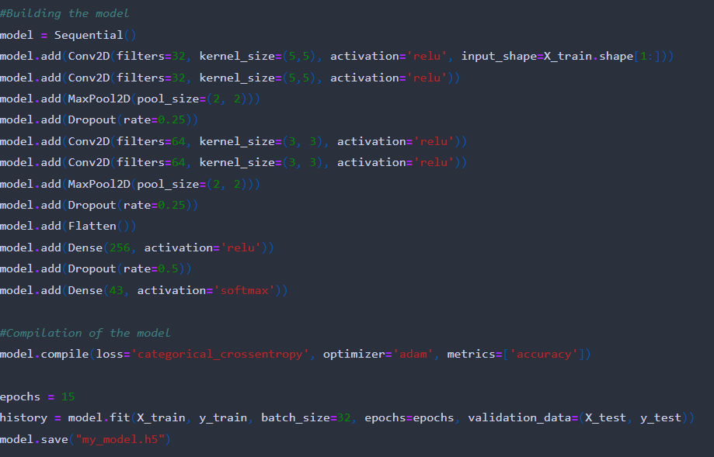
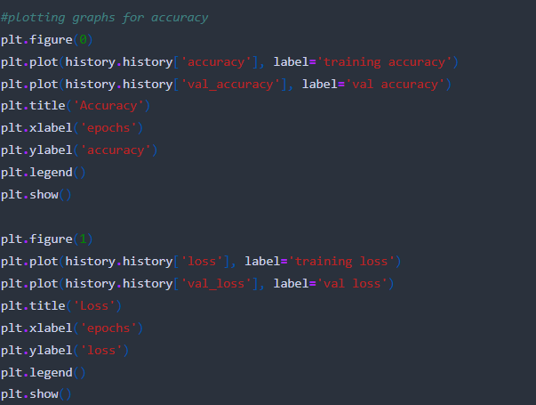
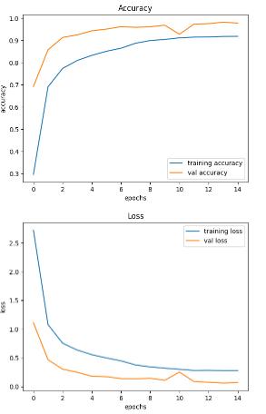
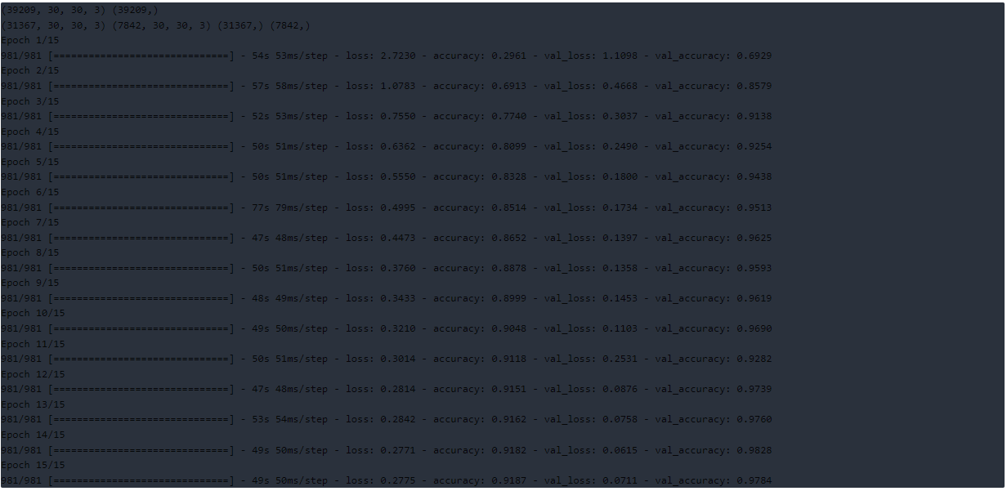
Model Building
Training and validation accuracy

Slide 9
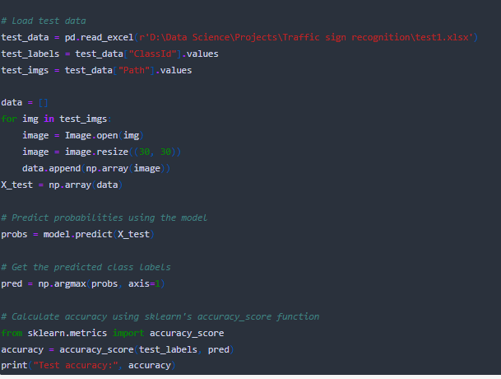
Model Evaluation
Model evaluation ensures understanding of real-world performance and accuracy
Load Test Data:
Utilized pandas to load test data from an Excel file.
Extracted test labels and image paths.
Predictions and Accuracy:
Predicted class probabilities using the trained model.
Converted probabilities to class labels.
Calculated accuracy using sklearn’s ’accuracy _score’ function.
Test Accuracy:
Displayed test accuracy achieved by the model.
Highlighted the accuracy achieved on the provided test data.

Slide 10
Deployment Using Tkinter
Deployment via Tkinter allows users to interact with the traffic sign recognition model easily.
Graphical User Interface (GUI):
Utilized Tkinter library for creating a user-friendly interface.l.
Integrated functionalities for uploading and classifying images..
Steps in Deployment:
User uploads an image through the GUI.
The uploaded image is displayed on the interface.
Upon clicking "Classify Image," the model predicts the traffic sign class.
The predicted class is displayed on the interface.
Tkinter Components:
Buttons, labels, and images display widgets.
Functionality to call the model for prediction.

Slide 11
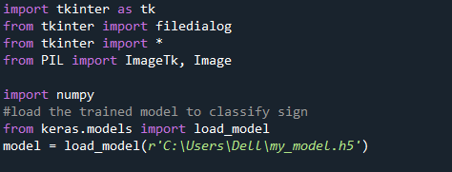
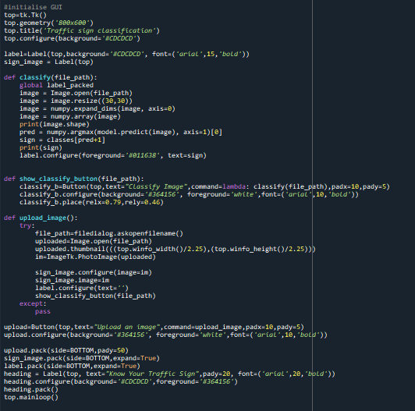
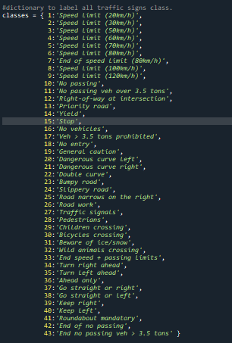
Library
GUI
Label all traffic signal

Slide 12
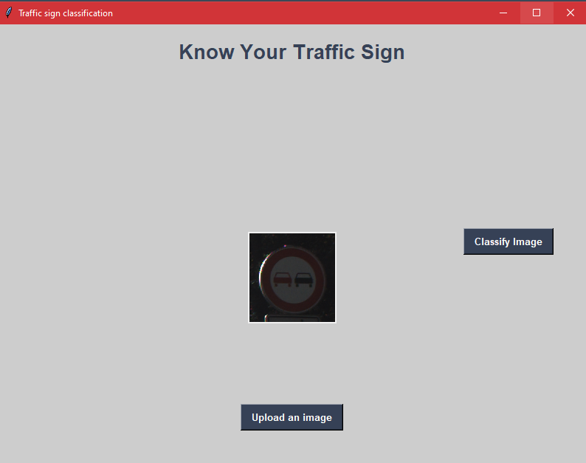
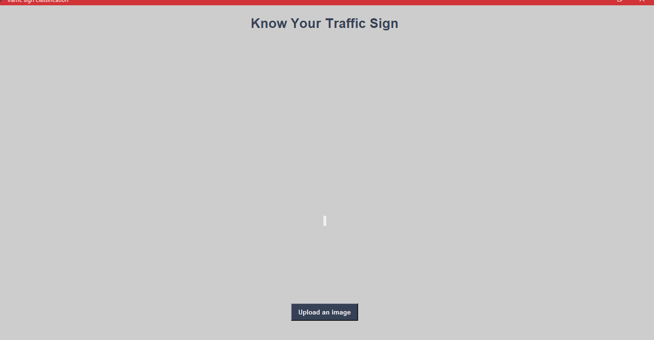
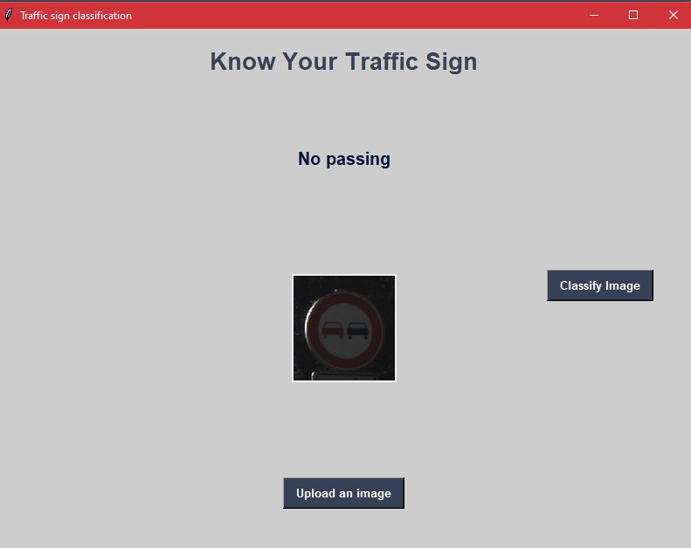
GUI Layout:
Upload Button: Select and upload an image.
Display Area: Show the uploaded image.
Result Label: Display the predicted traffic sign class
2
3
1

Slide 13
Classification Process, and Displaying Result
This user-friendly interface enables users to upload images and receive instant traffic sign predictions
Classification Process:
Uploaded image is resized for compatibility.
Image dimensions are expanded to match the model input shape.
Model predicts the class of the traffic sign.
Displaying Result:
The predicted class is displayed using the Label widget.
The user sees the recognized traffic sign label.

Slide 14
Conclusion
Project Accomplishments:
Successful development of a traffic sign recognition model using CNNs.
Implementation of a user-friendly GUI for real-time predictions.
Key Learnings:
Understanding of CNN architecture and its applications.
Practical experience in data preprocessing, model training, and deployment.
Future Possibilities:
Enhancements in model accuracy through data augmentation and fine-tuning.
Integration with real-time traffic monitoring systems.
Final Thoughts:
The project showcases the potential of deep learning in real-world applications.
The GUI-based deployment enhances accessibility and usability

Slide 15
Future Enhancements
These enhancements will refine the model's accuracy and usability, contributing to its real-world applicability.
Data Augmentation:
Increasing model robustness by introducing variations to training data.
Rotations, translations, and brightness adjustments.
Fine-Tuning:
Tweaking model hyperparameters to achieve higher accuracy.
Optimizing layer configurations and training strategies.
Real-time Integration:
Incorporating the model into real-time traffic management systems.
Enabling instant recognition of traffic signs in live camera feeds.

Slide 16
References
[1] Brownlee, J. (2020). "A Gentle Introduction to Data Augmentation for Deep Learning." Machine Learning Mastery.
URL: https://machinelearningmastery.com/data-augmentation-for-deep-learning/
[2] Chollet, F. (2017). "Xception: Deep Learning with Depthwise Separable Convolutions." Proceedings of the IEEE Conference on Computer Vision and Pattern Recognition.
URL: https://arxiv.org/abs/1610.02357
[3] TensorFlow. (n.d.). "Convolutional Neural Networks (CNNs)." TensorFlow Tutorials.
URL: https://www.tensorflow.org/tutorials/images/cnn
[4] Tkinter Documentation. (n.d.). "Tkinter: Standard Python interface to the Tk GUI toolkit."
URL: https://docs.python.org/3/library/tkinter.html
[5] Sklearn Documentation. (n.d.). "sklearn.metrics.accuracy_score."
URL: https://scikit-learn.org/stable/modules/generated/sklearn.metrics.accuracy_score.html

Slide 17
Thank You !

